Slide 1


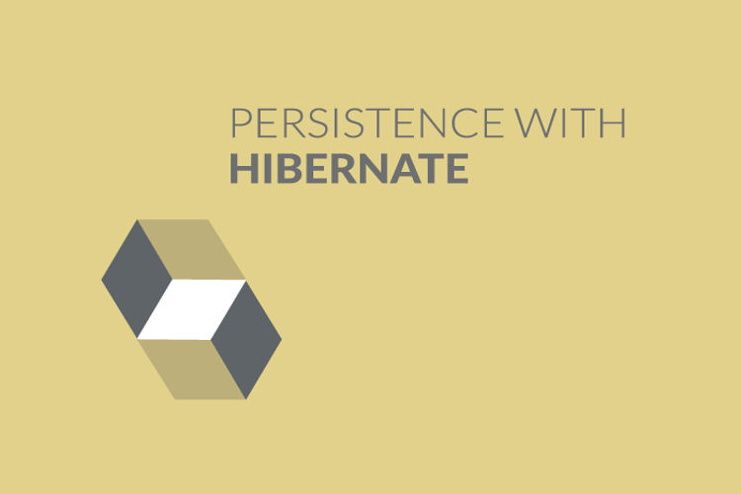
Using Generator Tag-Part 1
Chapter 12

Slide 2
Today’s Agenda
Using Generator Tag-Part 1
What Is Generator Tag ?
List Of All Predefined Generators
The Assigned Generator
The Increment Generator
The Sequence Generator
The Identity Generator
Identity V/s Increment

Slide 3
What Is <generator> Tag ?
The <generator> tag is an optional child element of the element <id> and is used to auto generate the primary key value.
There are many generator classes defined in the Hibernate Framework and all the generator classes implements the org.hibernate.id.IdentifierGenerator interface.

Slide 4
Syntax
<hibernate-mapping>
<class ...>
<id ...>
<generator class=“somevalue"></generator>
</id>
.....
</class>
</hibernate-mapping>

Slide 5
Predefined Generators
Class | Nickname
org.hibernate.id.AssignedGenerator | assigned
org.hibernate.id.IncrementGenerator | increment
org.hibernate.id.IdentityGenerator | identity
org.hibernate.id.NativeGenerator | native
org.hibernate.id.SequenceGenerator | sequence
org.hibernate.id.TableHiloGenerator | hilo
org.hibernate.id.SequenceHiloGenerator | seqhilo
org.hibernate.id.ForeignGenerator | foreign
org.hibernate.id.SelectGenerator | select

Slide 6
The Assigned Generator
It is the default generator strategy followed if there is no <generator> element mentioned in xml file.
In this case, application assigns the id.
Example:
<hibernate-mapping>
<class ...>
<id ...>
<generator class="assigned"></generator>
</id>
.....
</class>
</hibernate-mapping>

Slide 7
The Increment Generator
If we use "increment" generator class with in a Mapping File then:
First of all Hibernate Engine gets the Maximum record number from the Id column of a database table.
Then it increments that value by one and sets the Incremented value with in our persistence class.
Then finally it inserts the Record.

Slide 8
The Increment Generator
Example:
<hibernate-mapping>
<class ...>
<id ...>
<generator class=“increment"></generator>
</id>
.....
</class>
</hibernate-mapping>

Slide 9
The Sequence Generator
If we use “sequence" generator class with in a Mapping File then:
For first record the id value starts from starting value of sequence or the last generated value.
From the next record insertion onwards it adds sequence value.
We specify the name of the sequence in the <param> tag which is child tag of the <generator> tag

Slide 10
The Sequence Generator
If the programmer has not passed any sequence name, then hibernate creates its own sequence with name “Hibernate-Sequence” and gets next value from that sequence, and than assigns that id value for new record
But remember, if hibernate want’s to create its own sequence, then in hibernate configuration file, hbm2ddl.auto property must be set enabled

Slide 11
The Sequence Generator
Example:
<hibernate-mapping>
<class ...>
<id ...>
<generator class=“sequence">
<param name="sequence">your_sequence_name</param>
</generator>
</id>
.....
</class>
</hibernate-mapping>

Slide 12
The IdentityGenerator
This algorithm use identity value generated by identity columns available in DB2, mysql, SQL server, Sybase database software.
This algorithm returns identifier value of type long, short or int.
Identity column means the column that generates its next record value by using “Max value+1” formula

Slide 13
The IdentityGenerator
To make ordinary column as identity column in MySQL database software, we need to apply auto increment constraint on the table column.
To apply auto increment constraint the column must be of numeric data type and it should have primary key constraint.

Slide 14
The IdentityGenerator
create table PERSON
(
ID int(11) not null auto_increment,
NAME varchar(100) not null,
AGE int(11) not null,
PRIMARY KEY (ID)
);

Slide 15
The IdentityGenerator
The Java class is a simple POJO.
package com.sca;
public class Person
{
private Integer id;
private String name;
private Integer age;
//setter getters
}

Slide 16
The IdentityGenerator
The class name of this identifier algorithm is “org.hibernate.id.IdentityGenerator”
<id name=“id” column=“id”>
<generator class=“identity”/>
</id>

Slide 17
What About Oracle ?
Till Oracle 11g , there was no support for identity column but from Oracle 12c onwards the support came.
Hibernate also didn’t support Oracle based identity coulmn before Hibernate 5.x , although from version 5 onwards it started supporting it.
However we need to follow some special rules in order to use identity generator with Oracle.

Slide 18
What About Oracle ?
The table must be created with the special clause GENERATED BY DEFAULT ON NULL AS IDENTITY:
create table PERSON
(
id NUMBER(5) GENERATED BY DEFAULT ON NULL AS
IDENTITY,
Name VARCHAR2(30) NOT NULL,
Age number,
PRIMARY KEY (id)
);

Slide 19
What About Oracle ?
The dialect used in hibernate must be Oracle12cDialect and not any other dialect.

Slide 20
Increment V/s Identity
While working with increment algorithm the id field related table column is not required to have any constraint i.e constraints are optional.
Whereas while working with identity algorithm the id field related table column must have primary key, auto increment constraint.

Slide 21
Increment V/s Identity
For increment algorithm hibernate software generates the identity value.
On the other hand , in identity algorithm its the database software which generates identity value and hibernate simply collects & uses that value.

Slide 22
Increment V/s Identity
Increment algorithm works with all database software
Identity algorithm works with only those database software which support identity column (MySql, DB2 and later versions of Oracle)

